Slide 1
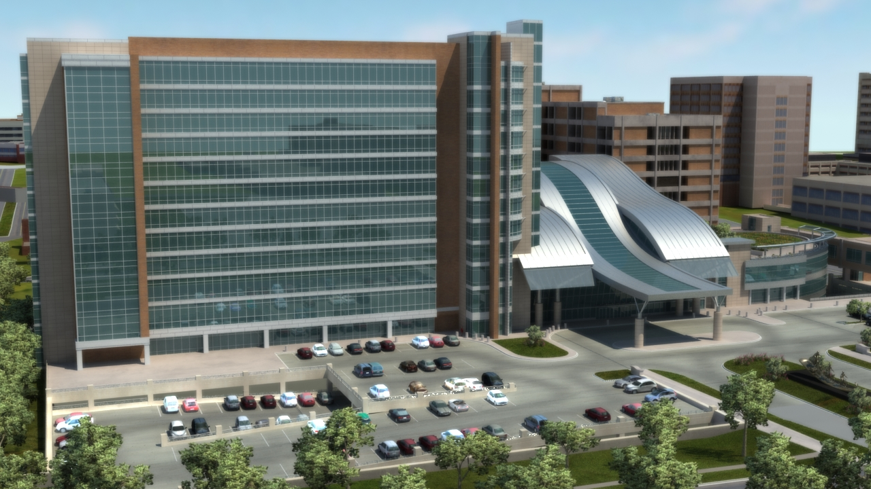
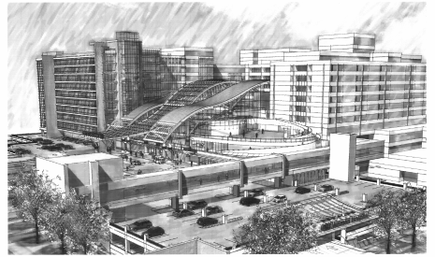
Oklahoma University Children’s
Medical Office Building
Oklahoma City, O.K.
Alec Canter, BAE
Mechanical Option
Advisor: Laura Miller

Slide 2
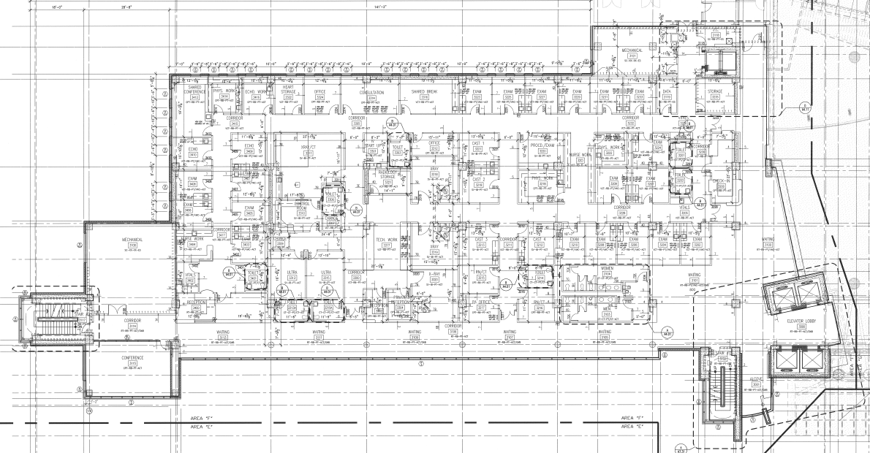
N
Presentation Outline
Project Background
Existing Conditions
Thesis Goals
Mechanical Depth
  VRF System
  Dedicated Outdoor Air System
  Evaluation
Acoustics Breadth
  VRF Indoor Units
  Design Criteria
  Room Noise Criteria
Conclusion
Alec Canter
Oklahoma University Children’s MOB
Mechanical Option

Slide 3
N
Project Background
Building Statistics
Project Background:
  Building Statistics
  Layout
Existing Conditions
Thesis Goals
Mechanical Depth
Acoustics Breadth
Conclusion
Location: Oklahoma City, Oklahoma
Size (Gross Square Feet): 337,000
12 Stories Above Grade, 1 Below
Function: Medical Office Building
Overall Project Cost: $ 60,000,000
Construction: Spring 2006 – Spring 2009
Alec Canter
Oklahoma University Children’s MOB
Mechanical Option

Slide 4
Project Background
Floor Layout
Room Locations
Project Background:
  Building Statistics
  Layout
Existing Conditions
Thesis Goals
Mechanical Depth
Acoustics Breadth
Conclusion
N
Offices, patient Rooms, and conference rooms populate the North and East exterior faces.
Waiting areas and the main lobby are located on the South and West side
All other labs, exam rooms, and special equipment rooms such a X-ray rooms dominate the interior
Alec Canter
Oklahoma University Children’s MOB
Mechanical Option

Slide 5
Existing Conditions
Mechanical Design
Mechanical Room Locations
Project Background
Existing Conditions:
  Mechanical System
  Design Conditions
  Energy Model Evaluation
Thesis Goals
Mechanical Depth
Acoustics Breadth
Conclusion
Floor-by-floor air handling systems
12 Air Handling Units in Total
Utilizes hydronic heat and cooling supplied by central plant to main mechanical room in the basement
VAV terminal units distribute air to each space
Heating water for zone reheat
Alec Canter
Oklahoma University Children’s MOB
Mechanical Option

Slide 6
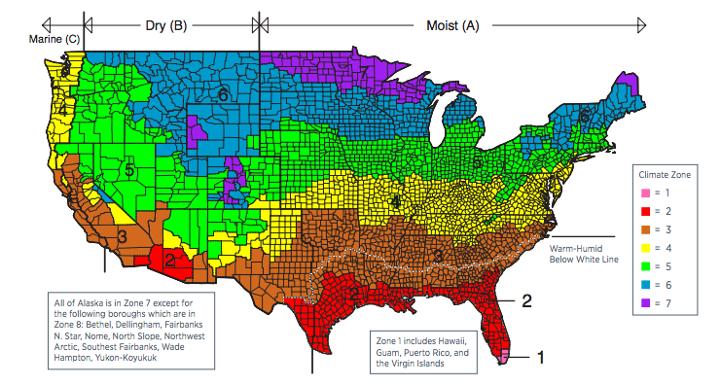
Existing Conditions
Climate Zone
Design Conditions
Project Background
Existing Conditions:
  Mechanical System
  Design Conditions
  Energy Model Evaluation
Thesis Goals
Mechanical Depth
Acoustics Breadth
Conclusion
Oklahoma City resides in Climate Zone 3A, which is characterized as being Warm-Humid
Design Settings | Summer | Winter
Outdoor Air Dry Bulb [ºF] | 96 | 17
Outdoor Air Wet Bulb [ºF] | 75 | -
Relative Humidity [%RH] | 50
Indoor Air Dry Bulb [ºF] | 75 | 72
Indoor Air Wet Bulb [ºF] | 62 | 60
Alec Canter
Oklahoma University Children’s MOB
Mechanical Option

Slide 7
Existing Conditions
Air Handling Unit Schedule
Energy Summary
Project Background
Existing Conditions:
  Mechanical System
  Design Conditions
  Energy Model Evaluation
Thesis Goals
Mechanical Depth
Acoustics Breadth
Conclusion
Floor | Design vs. Calculated Airflow
 | Designed [cfm] | Calculated [cfm] | Percent Error
Basement | 15000 | 10929 | 27.14
Third | 25000 | 25854 | 3.42
Fourth | 25000 | 25498 | 1.99
Fifth | 25000 | 25829 | 3.32
Sixth | 25000 | 26242 | 4.97
Seventh | 25000 | 25692 | 2.77
Eighth | 25000 | 26070 | 4.28
Ninth | 25000 | 23254 | 6.98
Tenth | 25000 | 23039 | 7.84
Alec Canter
Oklahoma University Children’s MOB
Mechanical Option

Slide 8
Existing Conditions
Emissions
Energy Consumption
Project Background
Existing Conditions:
  Mechanical System
  Design Conditions
  Energy Model Evaluation
Thesis Goals
Mechanical Depth
Acoustics Breadth
Conclusion
Energy Consumption
Site Energy [Btu/ft²-yr] | 86724
Source Energy [Btu/ft²-yr] | 234585
Estimated CO₂ Emissions: 6,152,946 lbm/year
Estimated No_{x} and SO₂ Emissions: 56 lbm/year
Total CO₂ Equivalent Emissions: 6,153,002 lbm/year
Alec Canter
Oklahoma University Children’s MOB
Mechanical Option

Slide 9
Thesis Goals
Energy Usage
Propose a system that could:
  Reduce energy use
  Reduce operating costs
  Reduce emissions
  Improve occupant temperature control
Project Background
Existing Conditions
Thesis Goals
Mechanical Depth
Acoustics Breadth
Conclusion
Operating Costs
Emissions
Occupant Comfort
Alec Canter
Oklahoma University Children’s MOB
Mechanical Option

Slide 10
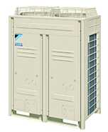
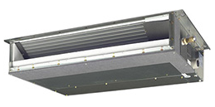
Mechanical Depth
Plan
Design a Variable Refrigerant Flow (VRF) system to serve each floor
  Condenser units will be located on the roof
  Indoor units will be paired with a DOAS
Replace existing air handling units on each floor to serve to zones 100% outdoor air and treat incoming air
  Indoor units will be ducted and served by DOAS
Project Background
Existing Conditions
Thesis Goals
Mechanical Depth:
  VRF Design
  Dedicated Outdoor Air System
  Evaluation
Acoustics Breadth
Conclusion
Alec Canter
Oklahoma University Children’s MOB
Mechanical Option

Slide 11
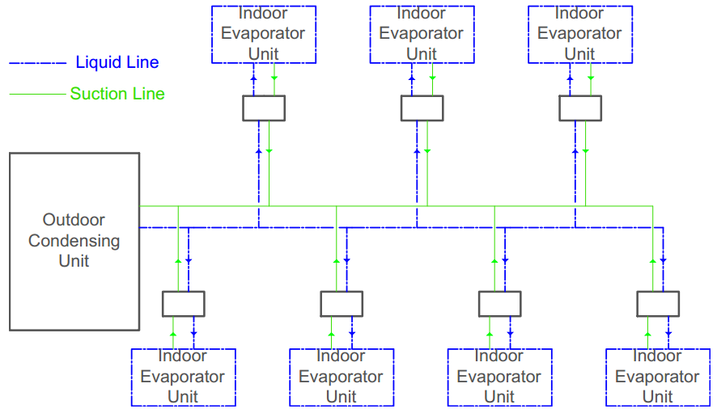
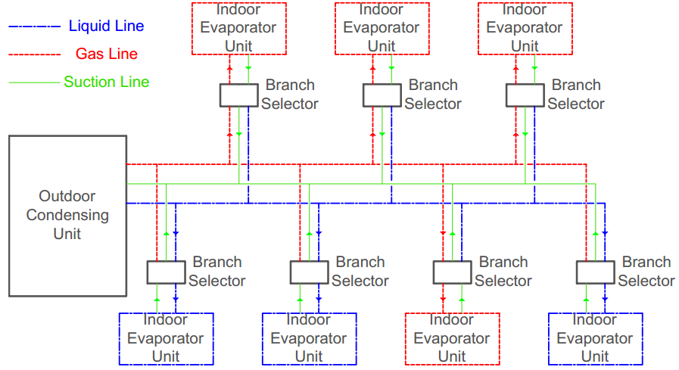
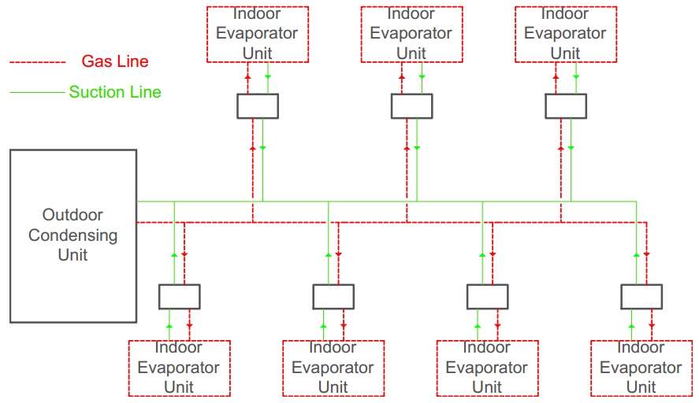
Mechanical Depth
Basic VRF Design
VRF with Heat Recovery
Project Background
Existing Conditions
Thesis Goals
Mechanical Depth:
  VRF Design
  Dedicated Outdoor Air System
  Evaluation
Acoustics Breadth
Conclusion
Cooling Mode
Basic Refrigeration Cycle
Heating Mode
Reverse Heat Pump Cycle
Outdoor Condensing Unit becomes Evaporator Unit
Alec Canter
Oklahoma University Children’s MOB
Mechanical Option

Slide 12
 | Exterior Peak Cooling [BTU/h] | Exterior Peak Cooling [Tons] | Equipment Cooling Capacity [Tons] | Interior Peak Cooling [BTU/h] | Interior Peak Cooling [Tons] | Equipment Cooling Capacity [Tons]
Floor 0 | - | - | - | 249004 | 20.75 | 20.00
Floor 3 | 355162 | 29.60 | 28.00 | 122452 | 10.20 | 10.00
Floor 4 | 311954 | 26.00 | 26.00 | 150737 | 12.56 | 12.00
Floor 5 | 327911 | 27.33 | 26.00 | 141228 | 11.77 | 12.00
Floor 6 | 364400 | 30.37 | 28.00 | 143120 | 11.93 | 12.00
Floor 7 | 363766 | 30.31 | 28.00 | 122886 | 10.24 | 10.00
Floor 8 | 353628 | 29.47 | 28.00 | 122504 | 10.21 | 10.00
Floor 9 | 310667 | 25.89 | 28.00 | 88743 | 7.40 | 12.00
Floor 10 | 335795 | 27.98 | 28.00 | 82749 | 6.90 | 8.00
Mechanical Depth
Loads per Floor
Typical Floor Layout
N
Project Background
Existing Conditions
Thesis Goals
Mechanical Depth:
  VRF Design
  Dedicated Outdoor Air System
  Evaluation
Acoustics Breadth
Conclusion
Floor | Cooling [tons] | Heating [MBH]
0 | 20.8 | 106.9
3 | 40.4 | 59.5
4 | 39.0 | 60.4
5 | 39.6 | 56.2
6 | 42.9 | 61.3
7 | 41.1 | 60.7
8 | 40.3 | 61.1
9 | 33.8 | 51.5
10 | 35.4 | 53.4
Alec Canter
Oklahoma University Children’s MOB
Mechanical Option

Slide 13
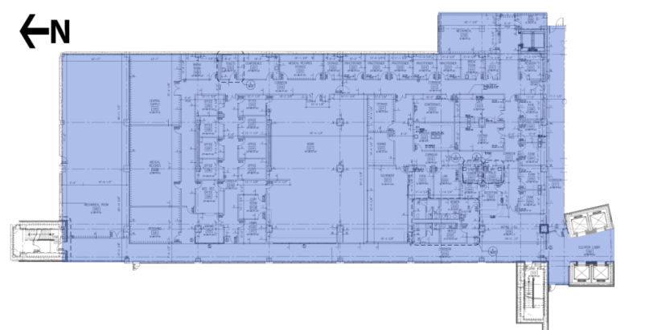
Mechanical Depth
Loads by Floor
Zone Design
Project Background
Existing Conditions
Thesis Goals
Mechanical Depth:
  VRF Design
  Dedicated Outdoor Air System
  Evaluation
Acoustics Breadth
Conclusion
Floor | Cooling [tons] | Heating [MBH]
0 | 20.8 | 106.9
3 | 40.4 | 59.5
4 | 39.0 | 60.4
5 | 39.6 | 56.2
6 | 42.9 | 61.3
7 | 41.1 | 60.7
8 | 40.3 | 61.1
9 | 33.8 | 51.5
10 | 35.4 | 53.4
Basement Floor Zone Designation
Alec Canter
Oklahoma University Children’s MOB
Mechanical Option

Slide 14
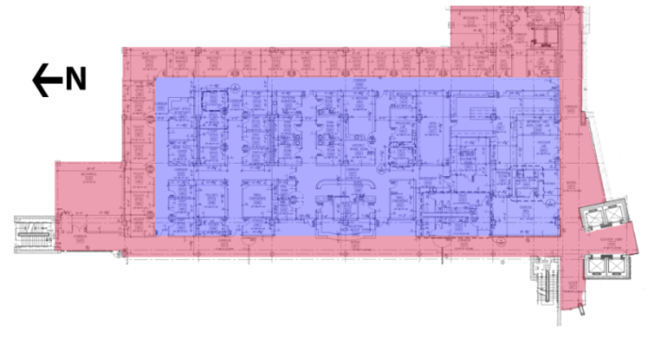
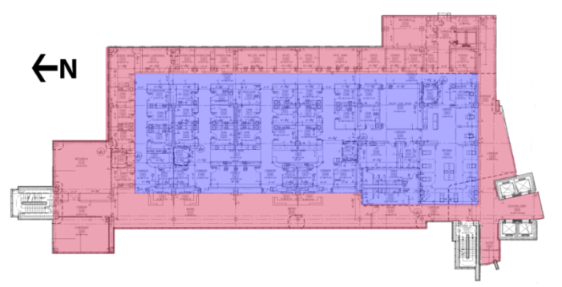
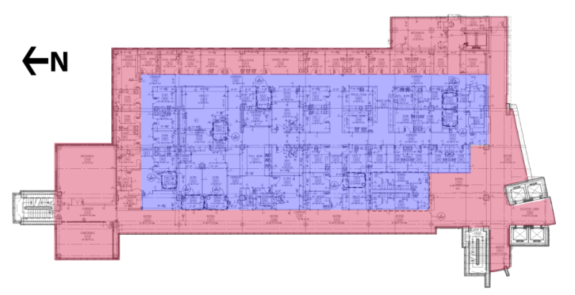
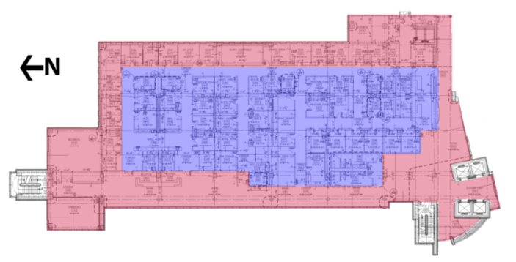
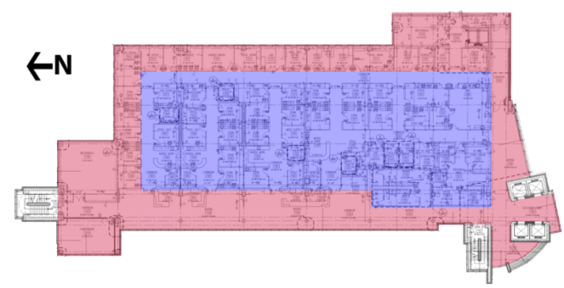
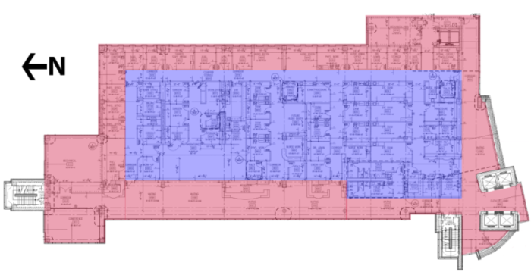
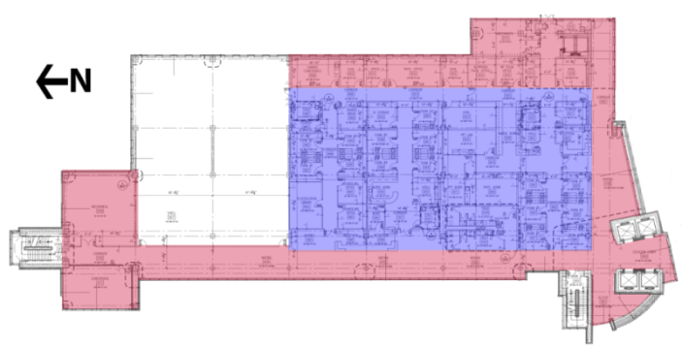
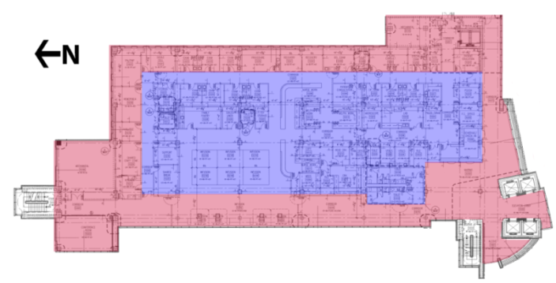
Zone Design
Mechanical Depth
Typical Zone Layout
Project Background
Existing Conditions
Thesis Goals
Mechanical Depth:
  VRF Design
  Dedicated Outdoor Air System
  Evaluation
Acoustics Breadth
Conclusion
4th Floor
5th Floor
6th Floor
7th Floor
8th Floor
9th Floor
3rd Floor Zone Designation
10th Floor
Alec Canter
Oklahoma University Children’s MOB
Mechanical Option

Slide 15
Mechanical Depth
Condenser Schedule
General Design Requirements
Project Background
Existing Conditions
Thesis Goals
Mechanical Depth:
  VRF Design
  Dedicated Outdoor Air System
  Evaluation
Acoustics Breadth
Conclusion
Floor/Units | Condenser Unit Sizes
 | Interior Zone [tons] | Exterior Zone [tons]
F0/CU-1,CU-2 | 20 | -
F3/CU-3,CU-4 | 10 | 28
F4/CU-5,CU-6 | 12 | 26
F5/CU-7,CU-8 | 12 | 26
F6/CU-9,CU-10 | 12 | 28
F7/CU-11,CU-12 | 10 | 28
F8/CU-13,CU-14 | 10 | 28
F9/CU-15,CU-16 | 8 | 26
F10/CU-16,CU-17 | 8 | 28
540 linear feet of piping between condensing unit and furthest located fan coil unit or equivalent
3,280 total one-way piping in the complete piping network
164 feet in vertical separation between the condensing unit and the fan coil units
49 feet in vertical separation between fan coil units
Alec Canter
Oklahoma University Children’s MOB
Mechanical Option

Slide 16
Mechanical Depth
Evaluation
System Power Requirements
Project Background
Existing Conditions
Thesis Goals
Mechanical Depth:
  VRF Design
  Dedicated Outdoor Air System
  Evaluation
Acoustics Breadth
Conclusion
Alec Canter
Oklahoma University Children’s MOB
Mechanical Option

Slide 17
Mechanical Depth
Evaluation
System Power Requirements
Project Background
Existing Conditions
Thesis Goals
Mechanical Depth:
  VRF Design
  Dedicated Outdoor Air System
  Evaluation
Acoustics Breadth
Conclusion
Alec Canter
Oklahoma University Children’s MOB
Mechanical Option

Slide 18
Mechanical Depth
Required Airflow Comparison
Fan Utilization
Project Background
Existing Conditions
Thesis Goals
Mechanical Depth:
  VRF Design
  Dedicated Outdoor Air System
  Evaluation
Acoustics Breadth
Conclusion
Floor | Required Airflow
 | Original Design [cfm] | Redesign [cfm] | Percent Difference
Basement | 10929 | 8912 | 18.46
Third | 25854 | 25225 | 2.43
Fourth | 25498 | 18438 | 27.69
Fifth | 25829 | 21691 | 16.02
Sixth | 26242 | 23180 | 11.67
Seventh | 25692 | 21704 | 15.52
Eighth | 26070 | 25412 | 2.52
Ninth | 23254 | 19379 | 16.66
Tenth | 23039 | 20708 | 10.12
Total | 212407 | 184648 | 13.07
Fan Energy Savings
Original Design [kBtu/yr] | Redesign [kBtu/yr] | Energy Saved [kBtu/yr]
969,700 | 741,400 | 228,300
Alec Canter
Oklahoma University Children’s MOB
Mechanical Option

Slide 19
Mechanical Depth
Energy
Emissions
Project Background
Existing Conditions
Thesis Goals
Mechanical Depth:
  VRF Design
  Dedicated Outdoor Air System
  Evaluation
Acoustics Breadth
Conclusion
Energy Consumption Breakdown | Existing [kBtu/yr] | Redesign [kBtu/yr] | Reduction [kBtu/yr]
Heating | 2796067 | 98689 | 2697378
Cooling | 3351931 | 2496724 | 855207
Fans & Pumps | 969706 | 741378 | 228328
Lighting & Receptacle | 5742841 | 5742841 | -
Total | 12860545 | 9079632 | 3780913
Existing CO₂ Equivalent Production: 6,153,002 lbm/year
Redesign CO₂ Equivalent Production: 3,951,153 lbm/year
Total Reduction: 2,201,849 lbm/year ~64% Decrease
Occupant Comfort
Total Operating Cost:
Existing: $298,360/year, $1.55/ft²
Redesign: $179,028/year, $0.93/ft²
Total Annual Savings: $119,332
It is implied VRF Heat Recovery system design creates increased controllability by allowing simultaneous heating and cooling for occupant comfort
Alec Canter
Oklahoma University Children’s MOB
Mechanical Option

Slide 20
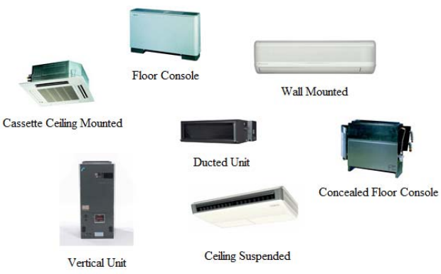
Acoustics Breadth
Sound Power Levels
Indoor Unit Types
Project Background
Existing Conditions
Thesis Goals
Mechanical Depth
Acoustics Breadth:
  VRF Indoor Units
  Design Criteria
  Room Noise Criteria
Conclusion
Model FXMQ_PVJU Ducted Concealed
Cooling Capacity |  | Sound Levels (dBA)
BTU/h | Tons | Cooling | Heating
7500 | 0.6 | 29 | 33
9500 | 0.75 | 29 | 333
12000 | 1 | 29 | 34
18000 | 1.5 | 37 | 41
24000 | 2 | 38 | 42
30000 | 2.5 | 39 | 43
36000 | 3 | 39 | 43
48000 | 4 | 40 | 44
Alec Canter
Oklahoma University Children’s MOB
Mechanical Option

Slide 21
Acoustics Breadth
Existing Sound Power Levels
VRF with DOAS Units
Project Background
Existing Conditions
Thesis Goals
Mechanical Depth
Acoustics Breadth:
  VRF Indoor Units
  Design Criteria
  Room Noise Criteria
Conclusion
Octave Band (Hz) | 63 | 125 | 250 | 500 | 1000 | 2000 | 4000 | 8000
Supply Fan Power Level, L_{w} (dB) | 94 | 94 | 88 | 87 | 85 | 83 | 78 | 72
Return Power Level, Lw (dB) | 84 | 86 | 77 | 77 | 76 | 74 | 64 | 60
Combined Sound Power Level, L_{w} (dB) | 94 | 95 | 88 | 87 | 86 | 84 | 78 | 72
Octave Band (Hz) | 63 | 125 | 250 | 500 | 1000 | 2000 | 4000 | 8000
Supply Fan Power Level, L_{w} (dB) | 90 | 91 | 85 | 84 | 84 | 81 | 76 | 71
Exhaust Fan Power Level, L_{w} (dB) | 76 | 77 | 76 | 73 | 71 | 68 | 65 | 60
Combined Sound Power Level, L_{w} (dB) | 90 | 91 | 86 | 84 | 84 | 81 | 76 | 71
Octave Band (Hz) | 63 | 125 | 250 | 500 | 1000 | 2000 | 4000 | 8000
VAV Sound Power Level, L_{w} (dB) | 60 | 60 | 54 | 44 | 42 | 39 | 34 | 34
Octave Band (Hz) | 63 | 125 | 250 | 500 | 1000 | 2000 | 4000 | 8000
VRF Sound Power Level, L_{w} (dB) | 44 | 49 | 40 | 37 | 38 | 34 | 22 | 14
Alec Canter
Oklahoma University Children’s MOB
Mechanical Option

Slide 22
Acoustics Breadth
Spectrum Noise Levels
Project Background
Existing Conditions
Thesis Goals
Mechanical Depth
Acoustics Breadth:
  VRF Indoor Units
  Design Criteria
  Room Noise Criteria
Conclusion
Octave Band (Hz) | 63 | 125 | 250 | 500 | 1000 | 2000 | 4000 | 8000
VAV-AHU Sound Power Level at Room | 60 | 63 | 62 | 23 | 6 | 0 | 43 | 44
VAV-AHU Sound Pressure Level | 49 | 52 | 51 | 12 | 0 | 0 | 32 | 33
VRF-DOAS Sound Power Level at Room | 55 | 60 | 58 | 13 | 0 | 0 | 7 | 6
VRF-DOAS Sound Pressure Level | 44 | 49 | 47 | 2 | 0 | 0 | 0 | 0
Alec Canter
Oklahoma University Children’s MOB
Mechanical Option

Slide 23
Acoustics Breadth
NC-Ratings by Floor
Evaluation
NC-Rating
Floor | Room Designation | Existing | Redesign
0 | Waiting Room | 42 | 37
3 | Exam Room | 45 | 46
4 | Faculty Office | 45 | 38
5 | Exam Room | 44 | 45
6 | Vitals Area | 51 | 55
7 | Dictation Room | 53 | 54
8 | Consultation | 51 | 49
9 | Reception Area | 39 | 33
10 | Shared Break Room | 50 | 50
Project Background
Existing Conditions
Thesis Goals
Mechanical Depth
Acoustics Breadth:
  VRF Indoor Units
  Design Criteria
  Room Noise Criteria
Conclusion
Noise Criteria levels are based on the background noise present within the space
Overall, 50% of the rooms investigated with the combine VRF-DOAS system performed better than the existing VAV spectrum levels
The rooms that performed worse were within the standard Noise Criterion levels
Additionally, those that performed worse were within 4 NC-values
Therefore, the design is sufficient without needing any redesign
Alec Canter
Oklahoma University Children’s MOB
Mechanical Option

Slide 24
Conclusion
Overall Evaluation
Project Background
Existing Conditions
Thesis Goals
Mechanical Depth
Acoustics Breadth
Conclusion
VRF System with DOAS Investigation:
Increased Occupant Control
Decreased Energy Consumption
Decreased Operating Costs
Decreased Emissions
Recommended
Indoor Unit Acoustic Investigation:
Remains consistent with existing design
50% of spaces studied had improved background noise level with the indoor units and DOAS
Meets standard NC rating room requirements
Alec Canter
Oklahoma University Children’s MOB
Mechanical Option

Slide 25

Conclusion
Special Thanks:
Project Background
Existing Conditions
Thesis Goals
Mechanical Depth
Acoustics Breadth
Conclusion
The Pennsylvania State University Architectural Engineering Department
Thesis Advisor: Dr. Laura Miller
Jorge Charneco, AIA; Miles Associates
Thanks to all my family and friends
Alec Canter
Oklahoma University Children’s MOB
Mechanical Option

Slide 26
Questions?

